Slide 1




MACHINE LEARNING
BODY FAT PREDICTION
BY ABDULLAH IMRAN

Slide 2
TABLE OF CONTENTS
Introduction
Project Objectives
EDA
FEATURE ENGINEERING
ML Models
DL Models
Results and Achievements
Web Page
Conclusion
01
02
03
04
05
06
07
08
09

Slide 3
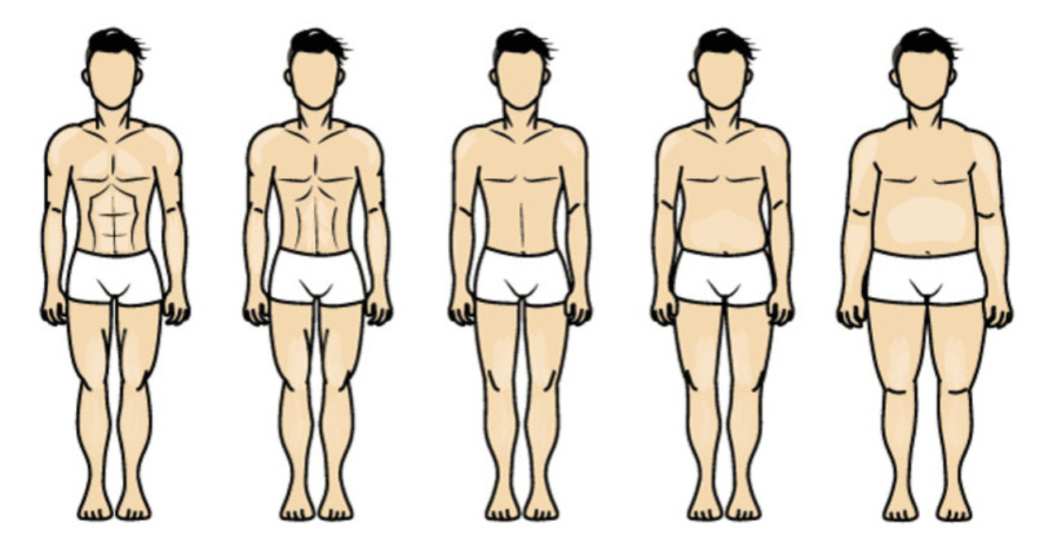
INTRODUCTION
Objective
The primary goal of this project is to leverage machine learning techniques to predict body fat percentage based on a range of health and lifestyle features. Accurate body fat prediction is crucial for personalized health insights and effective fitness planning.
Scope
Medical Relevance:
Accurate body fat prediction plays a crucial role in assessing an individual's health and risk factors for various medical conditions.
Scientific Insight:
By exploring and comparing different machine learning models, the project contributes to the understanding of how predictive analytics can be applied in the field of medicine, potentially influencing future research and clinical practices.

Slide 4






PROJECT OBJECTIVES
Support Evidence-Based Health Strategies
Improve Personalized Health Insights
Benchmark Predictive Model
Utilize cutting-edge machine learning algorithms to provide precise body fat predictions, empowering individuals and healthcare professionals with tailored health insights for better lifestyle and wellness choices.
Conduct a comprehensive evaluation of various machine learning models to determine the most accurate and reliable methods for body fat prediction, ensuring the highest level of precision and effectiveness in real-world applications.
Create intuitive and impactful visualizations of model predictions to aid in clinical decision-making and research, enhancing the ability to develop and implement data-driven health interventions and preventive measures.

Slide 5

EDA
Info of Dataset
Null Values
Skewness Handling
Duplication Check
Visualizing Features

Slide 6
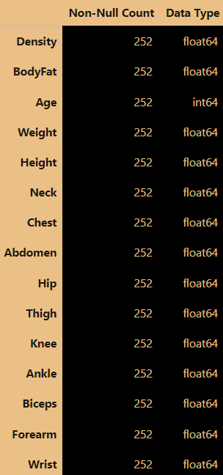
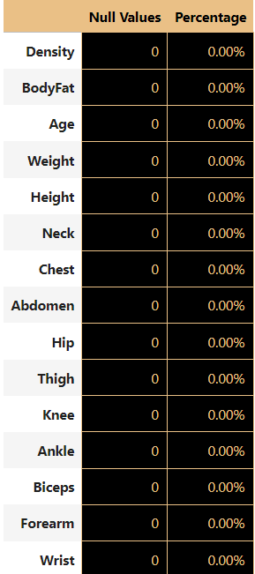
Information & Null Handling
Info of Dataset
Null Values Check
Null Values Count IN Each Feature With Percentage
Information regarding dataset, its column names and data type

Slide 7
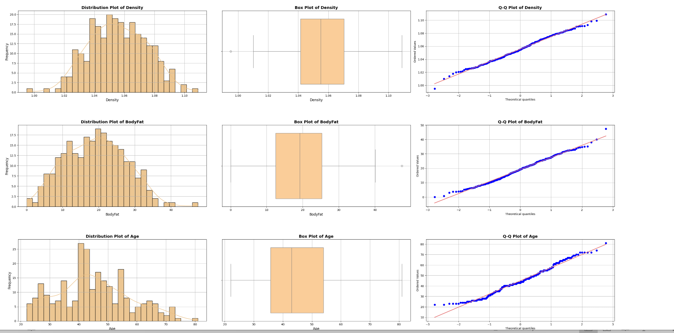
Visualizing Features

Slide 8
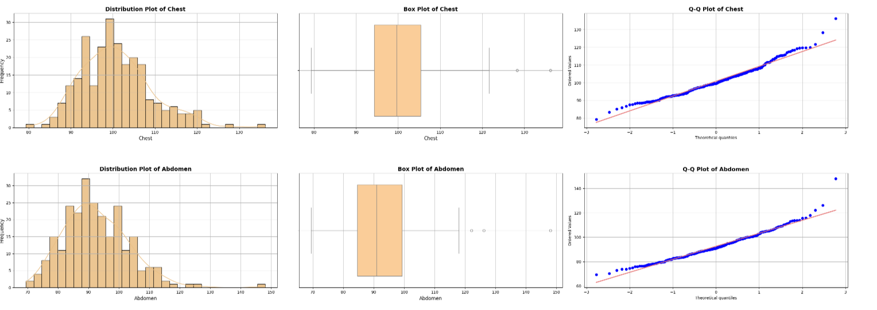

Slide 9
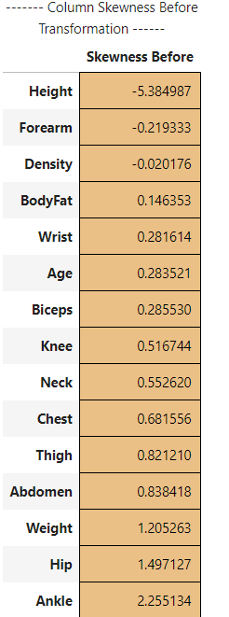
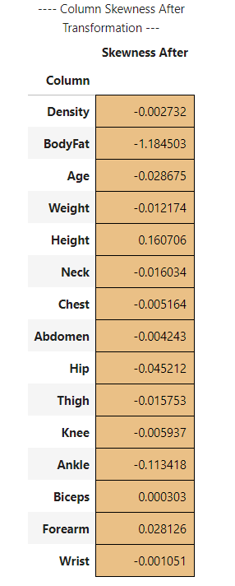
Skewness Handling
🧮 Skewed Elements in Dataset
Several features in the dataset show skewness, either positive or negative:
Negatively Skewed:
Height, Forearm, Density.
Positively Skewed:
Body Fat, Wrist, Age, Biceps, Knee, Neck, Chest, Thigh, Abdomen, Weight, Hip, Ankle.
Understanding these skewed elements helps in determining necessary transformations to improve model accuracy.
Skewness Handling Techniques 🧮
To handle skewness in the dataset:
Box-Cox Transformation
Applied to columns with all positive values to make their distribution more normal.
2. Log Transformation:
Applied to columns with zero or negative values, adjusting them for normality by shifting and scaling.
These techniques effectively reduced the skewness in most features, leading to more balanced data and improved model performance.

Slide 10
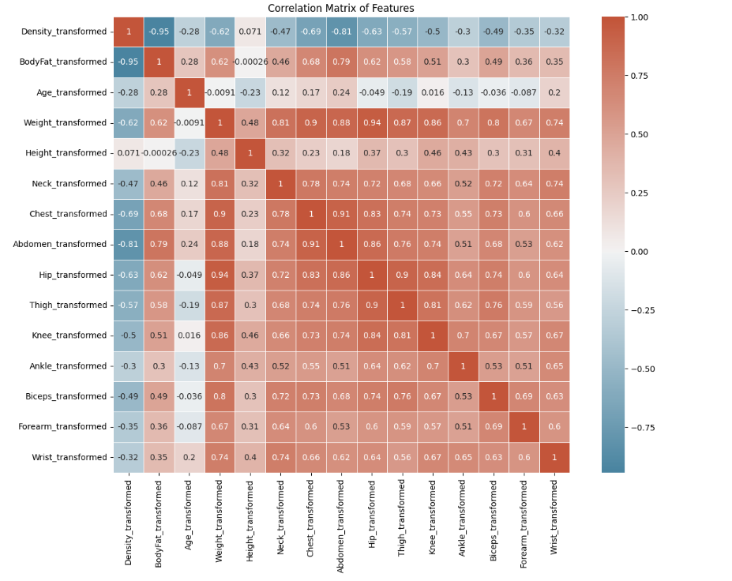
Correlation Matrix

Slide 11

FEATURE ENGINEERING
Adding New Features
Feature Extraction
Outlier Handling
Feature Scaling

Slide 12
🆕 New Features Added
📊 Body Mass Index (BMI): A key health metric, combining weight and height to provide a snapshot of overall body fat.
📏 Waist-to-Hip Ratio: A critical measure to understand fat distribution, helping to assess risks related to heart health.
📐 Body Surface Area (BSA): Utilizes advanced calculations to determine total body size, essential for personalized medical treatments.
⏳ Age Squared: A unique feature that captures the non-linear impact of age on body composition, revealing hidden trends.
🔍 Abdomen-to-Chest Ratio: Offers insights into upper body fat distribution, aiding in cardiovascular health assessments.
💪 Upper and Lower Body Fat: Separates fat accumulation into upper (Neck, Chest, Biceps) and lower (Thigh, Knee, Ankle) body areas for a more targeted health analysis.
💪🏽 Arm Fat Index: Evaluates arm fat using biceps, forearm, and wrist measures, providing a nuanced view of fat distribution across the arms.
These creative features combine domain-specific insights with data-driven innovation, adding depth and precision to our health analysis toolkit! 🌟

Slide 13
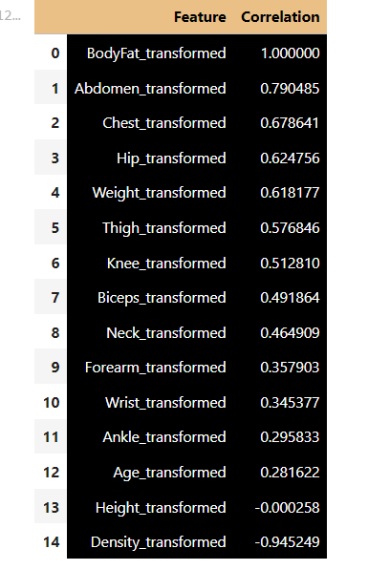
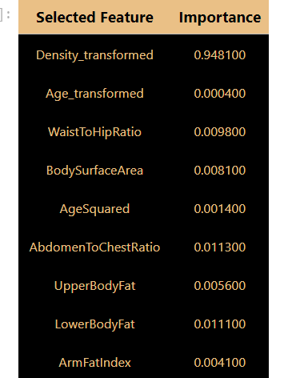
Feature Importance / Extraction
Correlation Analysis
Recursive Feature Elimination (RFE)
Feature Importance Before Refinement
Feature Importance Analysis After Refinement
After refining the dataset by adding new domain-specific features and removing less relevant ones, the importance of each feature in predicting body fat percentage was re-evaluated
)

Slide 14
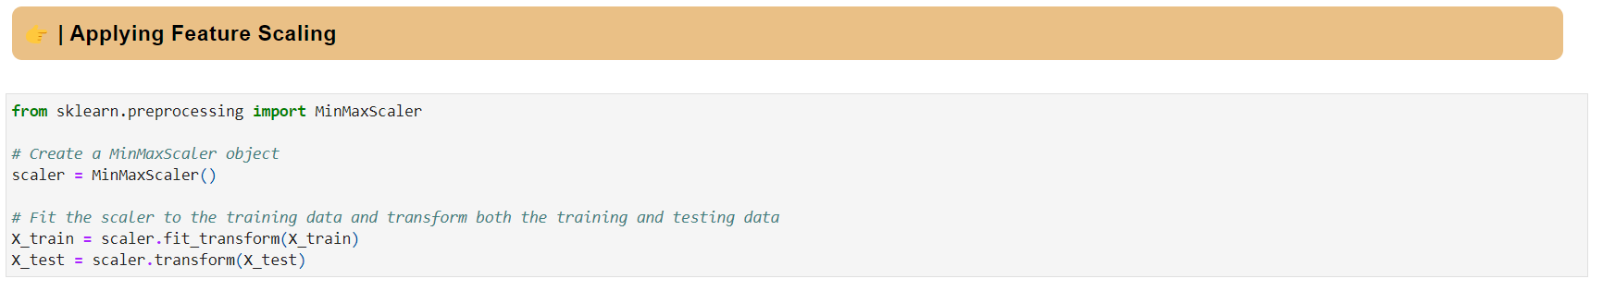
🔍 Applied Feature Scaling After Separating X and Y
After separating the features (X) and the target variable (Y), it is essential to apply feature scaling to normalize the data for effective model training. Here's a summary of the scaling steps:
🔬 Standardization of Features: Each feature in the dataset (X) was standardized to have a mean of 0 and a standard deviation of 1. This helps the model converge faster and improves accuracy by ensuring all features contribute equally to the model's learning process.
🚀 Why Scaling Matters: Feature scaling aligns different ranges and magnitudes of data, preventing the model from being biased toward features with larger numeric ranges. This is particularly important for algorithms like Gradient Descent or those that compute distances between points
⚙️ Implementation: Feature scaling was applied using the StandardScaler from scikit-learn:

Slide 15




Machine Learning Models
Hypermeter Tuning
Model Development Using Best Parameters
Training
Evaluation
Prediction
Comparison For Finding Best ML Model Among Used
Saving Best Model For Deployment

Slide 16
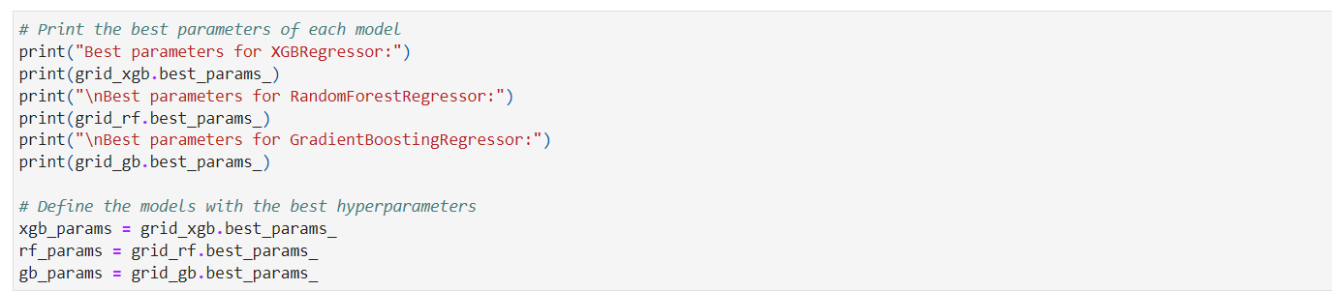
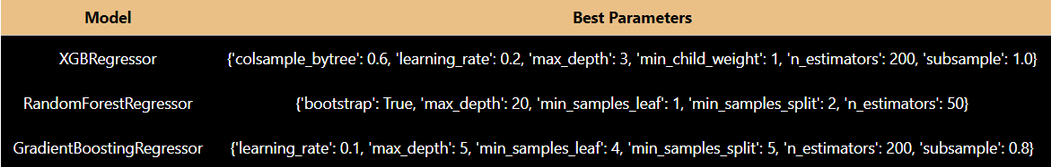
Hypermeter Tuning

Slide 17
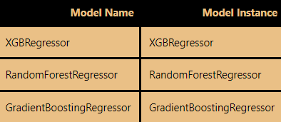
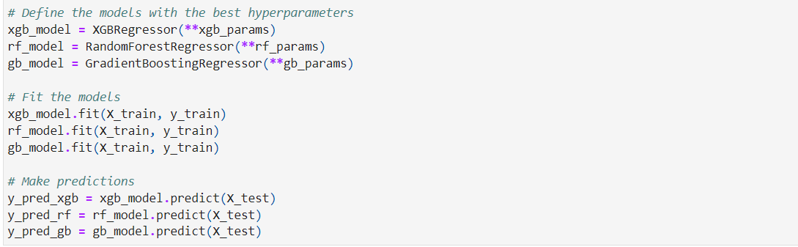
Model Fitting & Training
Here After Finding The Best Parameters, I am Creating A New Instance of Model
Then Fitting The Model A& Training It

Slide 18
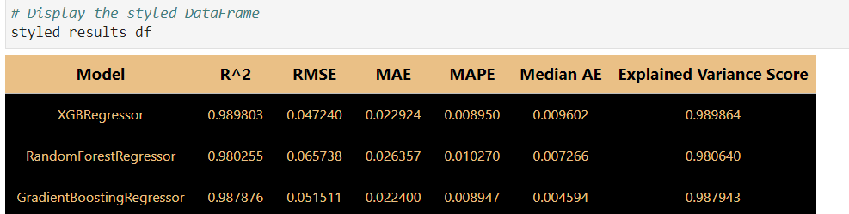
Evaluation of Models
Metrics Used For Evaluation
R²: Measures how well the model explains the variance in the data.
RMSE: Assesses the average squared difference between predicted and actual values.
MAE: Evaluates the average magnitude of prediction errors.
MAPE: Represents prediction accuracy as a percentage.
Median AE: Calculates the median absolute error to handle outliers.
Explained Variance Score: Indicates the proportion of variance captured by the model.

Slide 19
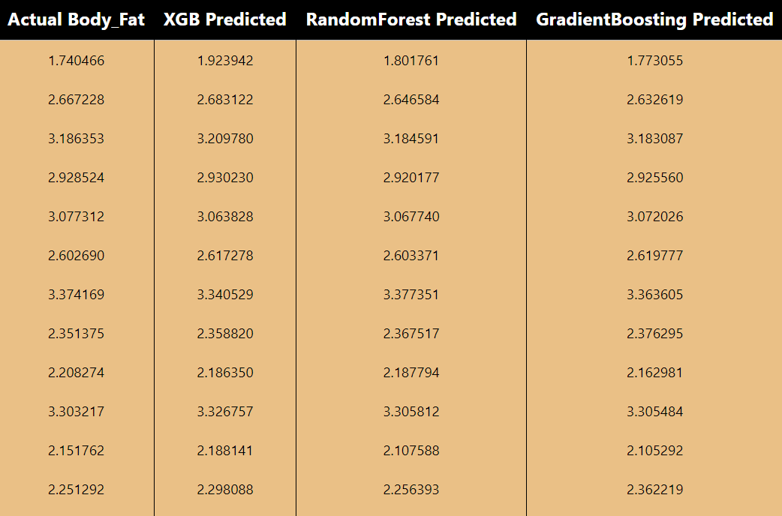
Predictions of Model
The table displays the actual body fat percentage compared to the predicted values from three different models: XGBoost, Random Forest, and Gradient Boosting.
Each model's predictions closely align with the actual values, showcasing their effectiveness in estimating body fat percentage.
Visualizing these predictions against actual values helps to evaluate model accuracy, identify trends, and highlight areas for improvement.

Slide 20
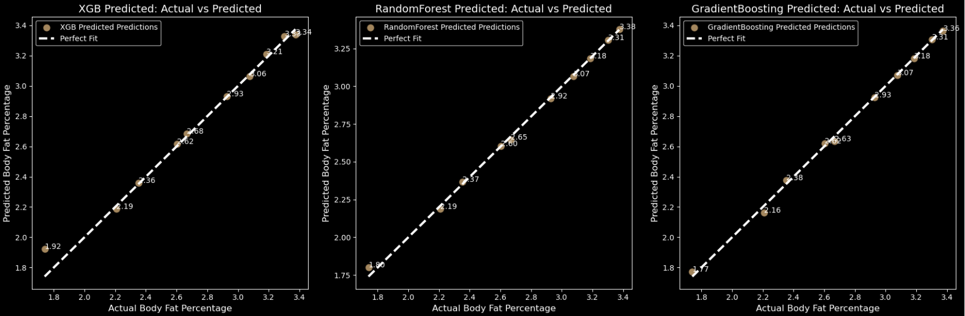
Plotting of Predictions

Slide 21
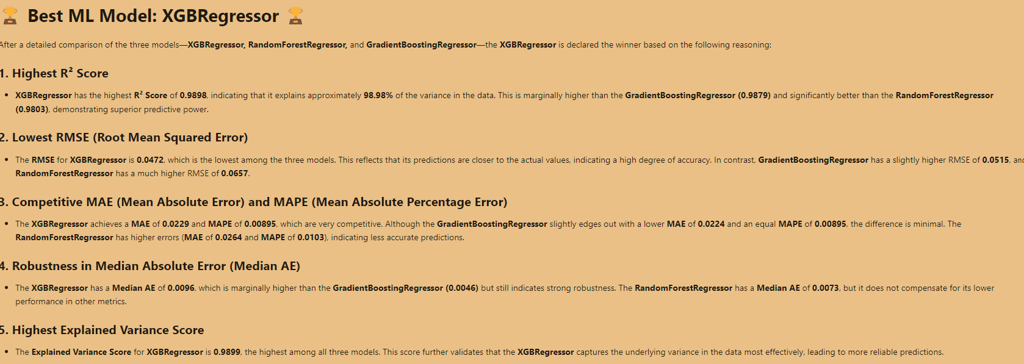
Picking Best ML Model

Slide 22


DL Models
Models Used
Overfitting & Under-Fitting Handling
Training
Evaluation
Prediction
Best DL Model Selection

Slide 23
Deep Learning Models
Feedforward Neural Network (FNN):
Utilizes 2 hidden layers with RELU activation, optimized by Adam with Mean Squared Error as the loss function, incorporating early stopping to enhance training efficiency.
Deep Neural Network with Dropout:
Applies dropout regularization to prevent overfitting, boosting model robustness and performance on new data.

Slide 24
Model Enhancements for Optimal Performance
Early Stopping:
Utilized to monitor validation loss, allowing the model to stop training early when improvements are minimal, with patience set to 10 epochs and a sensitive delta of 0.0005 to capture subtle gains, while restoring the best weights.
Dropout and Regularization:
To mitigate overfitting, the model incorporates dropout layers and L1/L2 regularization techniques, adding robustness by randomly deactivating neurons and penalizing large weights to improve generalization.
Under-Fitting Prevention:
To combat under-fitting, the model complexity is increased by adding more hidden layers or neurons, while carefully tuning dropout rates and regularization parameters to ensure the model learns effectively without becoming overly simplistic.

Slide 25
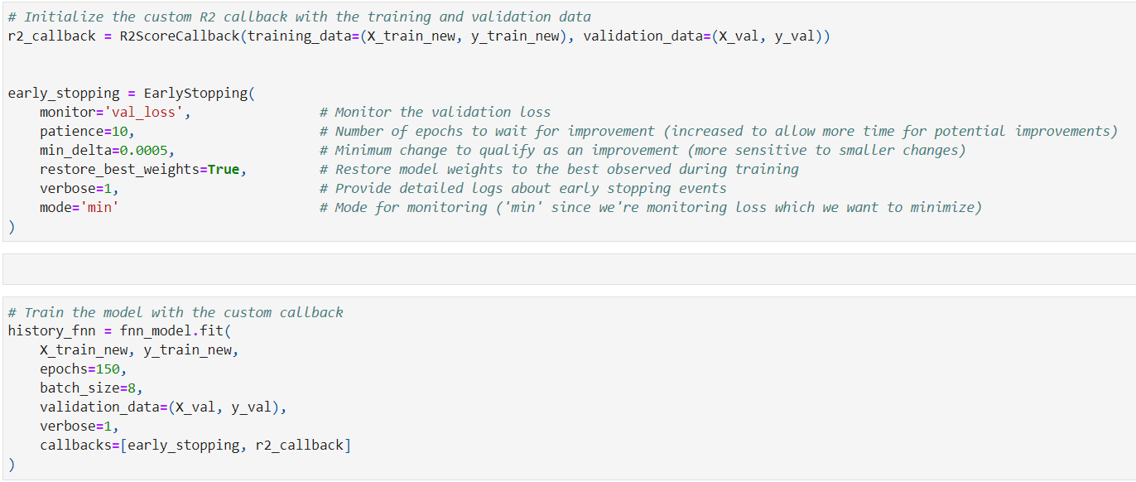
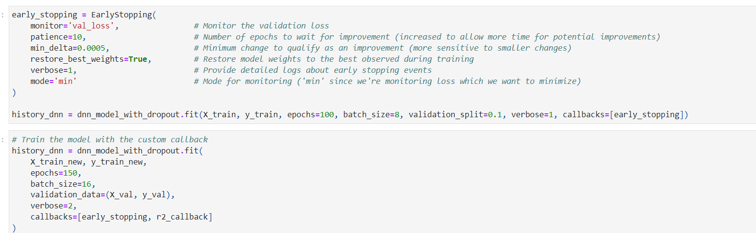
FNN Model Training
DNN Model Training

Slide 26
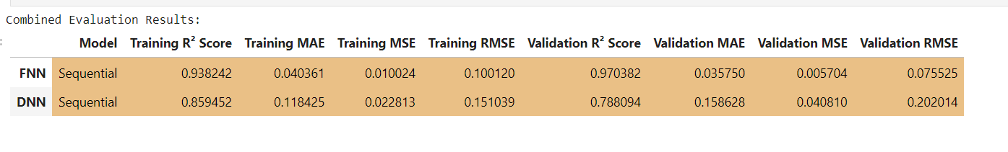
Evaluation of Models
Creating a Combined Evaluation DF Which Shows Results of Both The Models
R² Score: Measures how well the model's predictions match the actual values, both during training and validation.
MAE (Mean Absolute Error): Represents the average magnitude of errors in predictions, showing how close predictions are to actual values.
MSE (Mean Squared Error): Evaluates the average of the squared differences between predictions and actual values, emphasizing larger errors.
RMSE (Root Mean Squared Error): Provides the square root of MSE, offering a measure of error magnitude in the same units as the target variable

Slide 27
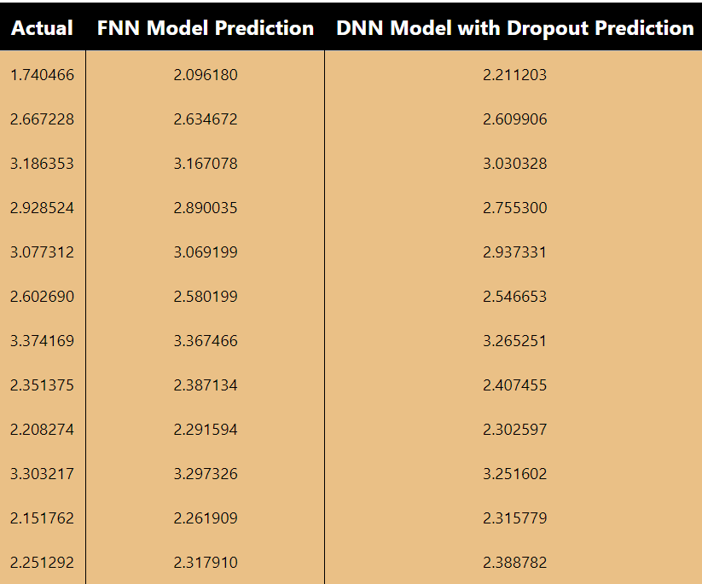
Predictions of Models
The table displays the actual body fat percentage compared to the predicted values from two different models: FNN & DNN
Each model's predictions closely align with the actual values, showcasing their effectiveness in estimating body fat percentage.

Slide 28
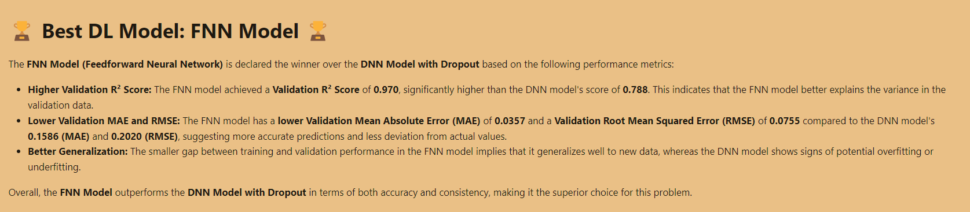
Best DL Model
Among The Two DL Models, FNN Model Is The Winner

Slide 29
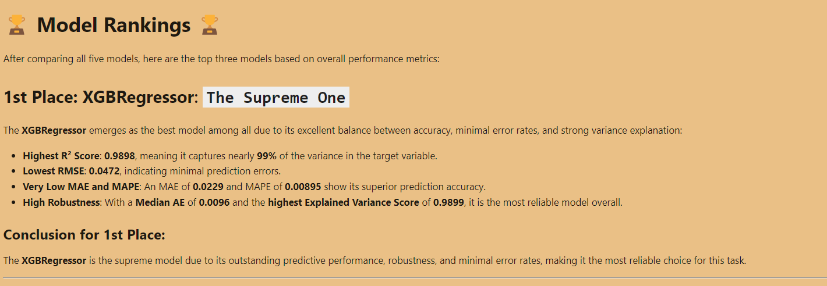
Conclusion
Between ML VS DL War ,
Here are The Final Top 3 Standings

Slide 30
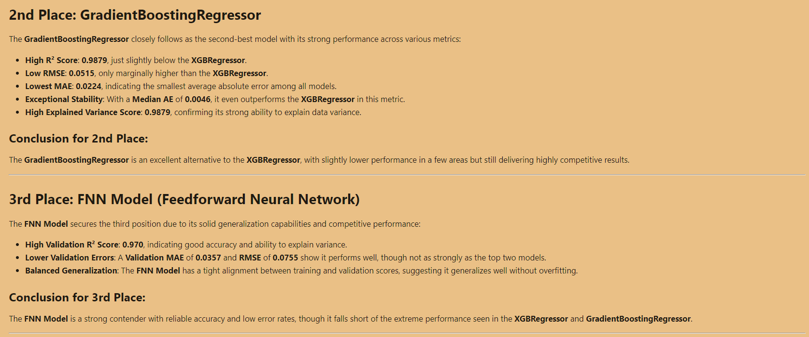

Slide 31
Web-Page
Login Page
Prediction Page
Recommendations Page
01
02
03

Slide 32
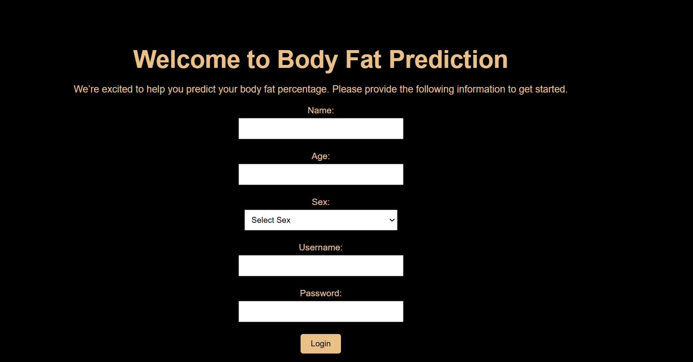
Login Page
User Need To Enter Personal Details To Login And Go To Prediction Page

Slide 33
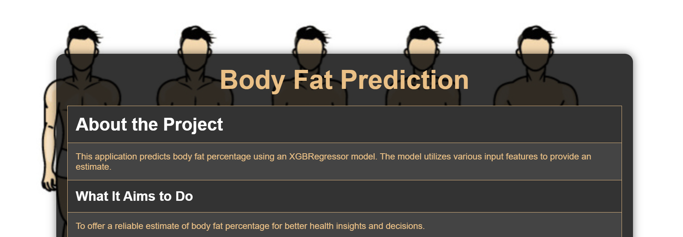
Prediction Page
User Needs To Add His / Her Measurements In Order To Predict Their Body Fat
Bit Change From Prediction Video, Did Some More Modifications

Slide 34
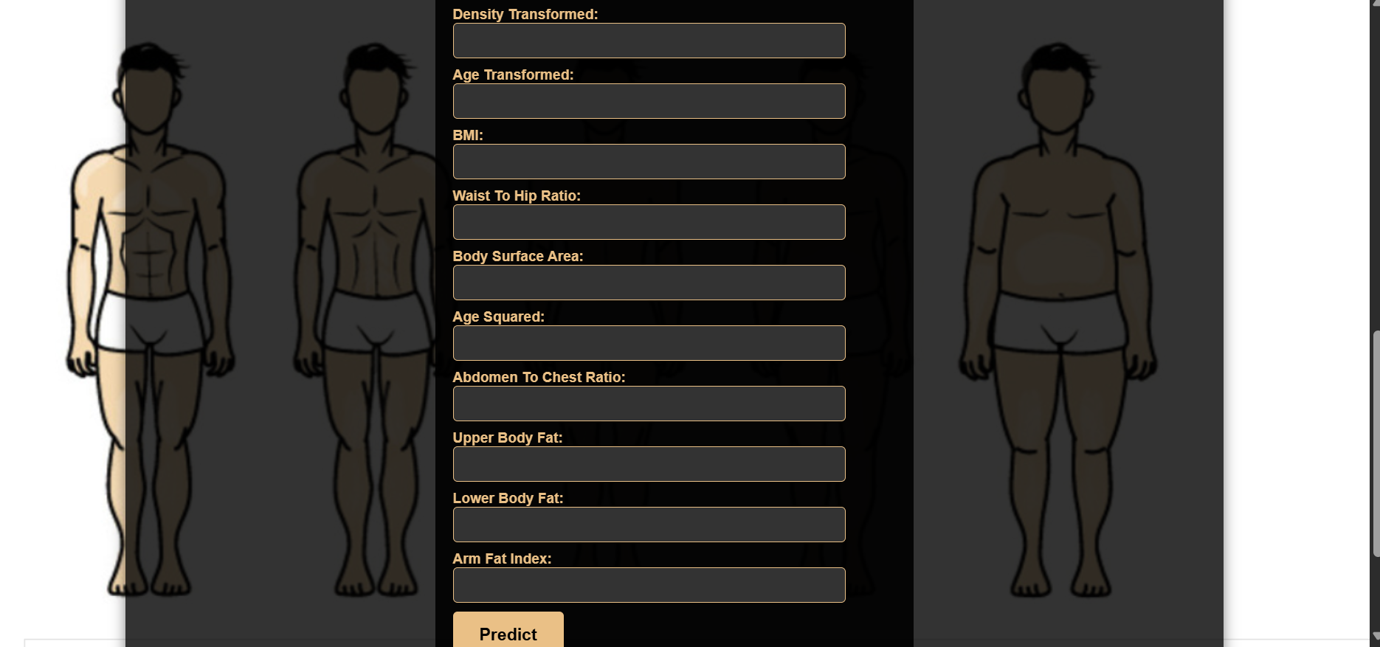
Input Section of Prediction Page

Slide 35
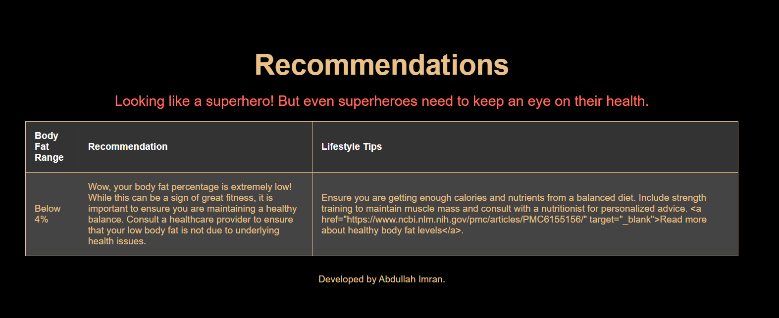
Recommendation Page
This Page Will Give Recomendations And Lifestyle Changing Tips According To The User’s Predicted Body Fat Range

Slide 36

THANK YOU!

